Slide 1
App development workshop
For Arduino/esp8266/pi …
Using BLYNK IoT platform

Slide 2
Workshop layout
What is Blynk
Install blynk on our device
Example 1: control LED brightness with your phone
Example 2: Read ultrasonic values on your phone

Slide 3

What is blynk
Platform with iOs and Android apps to control Arduino, Raspberry Pi and similar microcontroller boards over Internet.
Blynk supports:
Arduino, Raspberry pi, Node MCU, ESP8266 and …

Slide 4
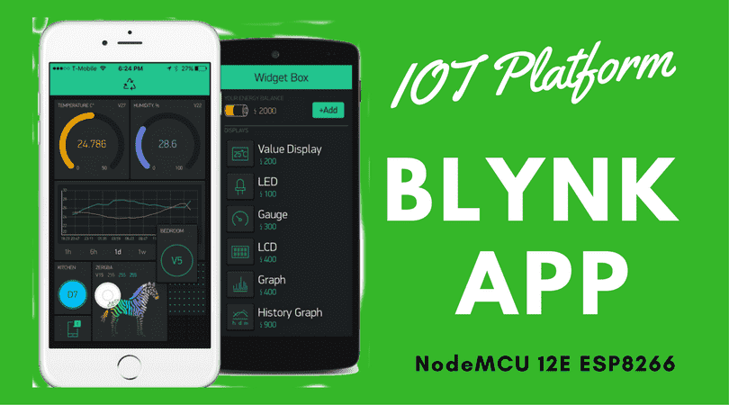
Get started
Download the app blynk on your Android/iOS device
Register with a valid Email
From the blynk website download and install the Arduino library

Slide 5
Example 1: control LED with your phone
Connect an LED to pin 13 and ground.
Connect your Arduino to your pc.
On Arduino IDE → File → Examples → Blynk → Boards_USB_Serial → Arduino_Serial_USB
Do not upload or compile the sketch yet.
Now you need to open the app, create a new project, Select your board and connection type, in this case USB.
A token will be sent to your registered Email, copy that and paste it in your Arduino sketch.

Slide 6
Example 1 (2)
Upload the sketch onto your board.
Now, locate the script files in library folder you downloaded. It should be in (C:\Users\user\Documents\Arduino\libraries\Blynk\scripts)
Copy the directory and open a terminal (cmd)
Type cd and paste the directory and hit enter
Then run the bat file with the correct COM, for example $ blynk-ser.bat –c COM4 then hit Enter.

Slide 7
Example 1 (3)
On the app, drag and drop a button, and set the pin to 13.
Click on the play button on top left.
And now you should be able to control the LED from your phone.

Slide 8
Example 2: distance meter
Connect your Arduino and Ultrasonic with this code
Now open the blynk sketch again, and add the following code:
Define trigger and echo pin
Define the function to write to virtual pin
BLYNK_WRITE (V5){ int pinValue = param.asInt(); }
Assign trigger as output and echo as input in the setup function
Copy paste your ultrasonic code into the loop as show
Write the distance to virtual pin

Slide 9
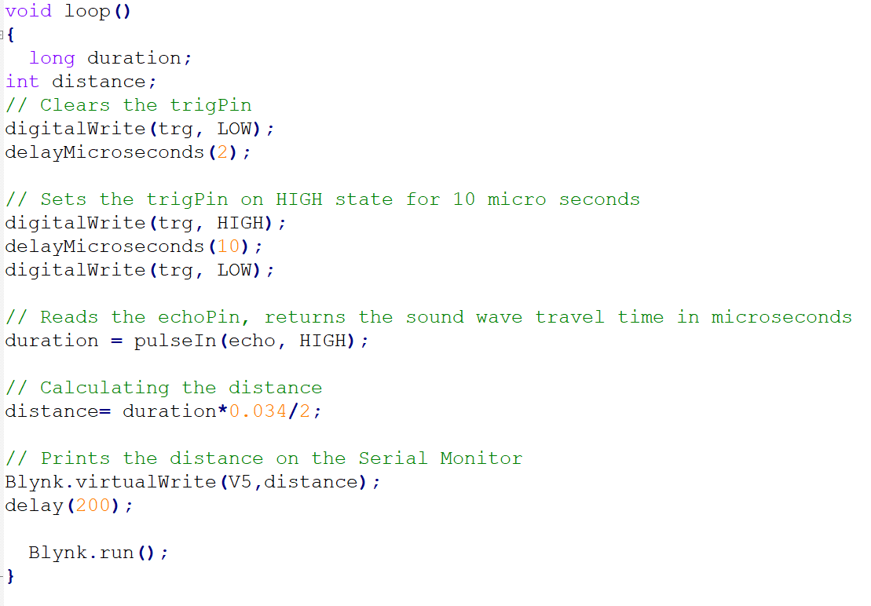
Example 2: Distance Meter (2)

Slide 10
Example 2: distance meter (3)
Upload your code, And run the bat file again
On the app, add a display widget and assign it to V5 ( Virtual pin)
Click on play and verify the distance

Slide 11
Links
Arduino + ESP8266
Raspberry pi
Servo Control
Stepper motor
DHT11 Temperature sensor
Log data to google sheets
PIR/IR Motion detection

